Slide 1
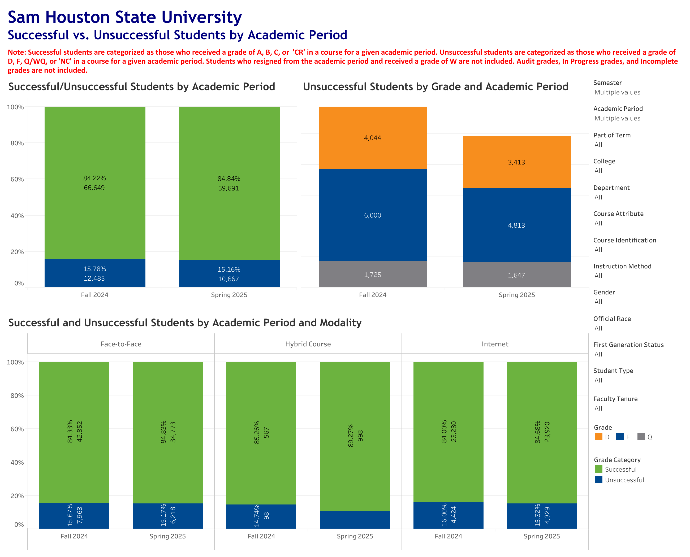
All courses F24-S25

Slide 2
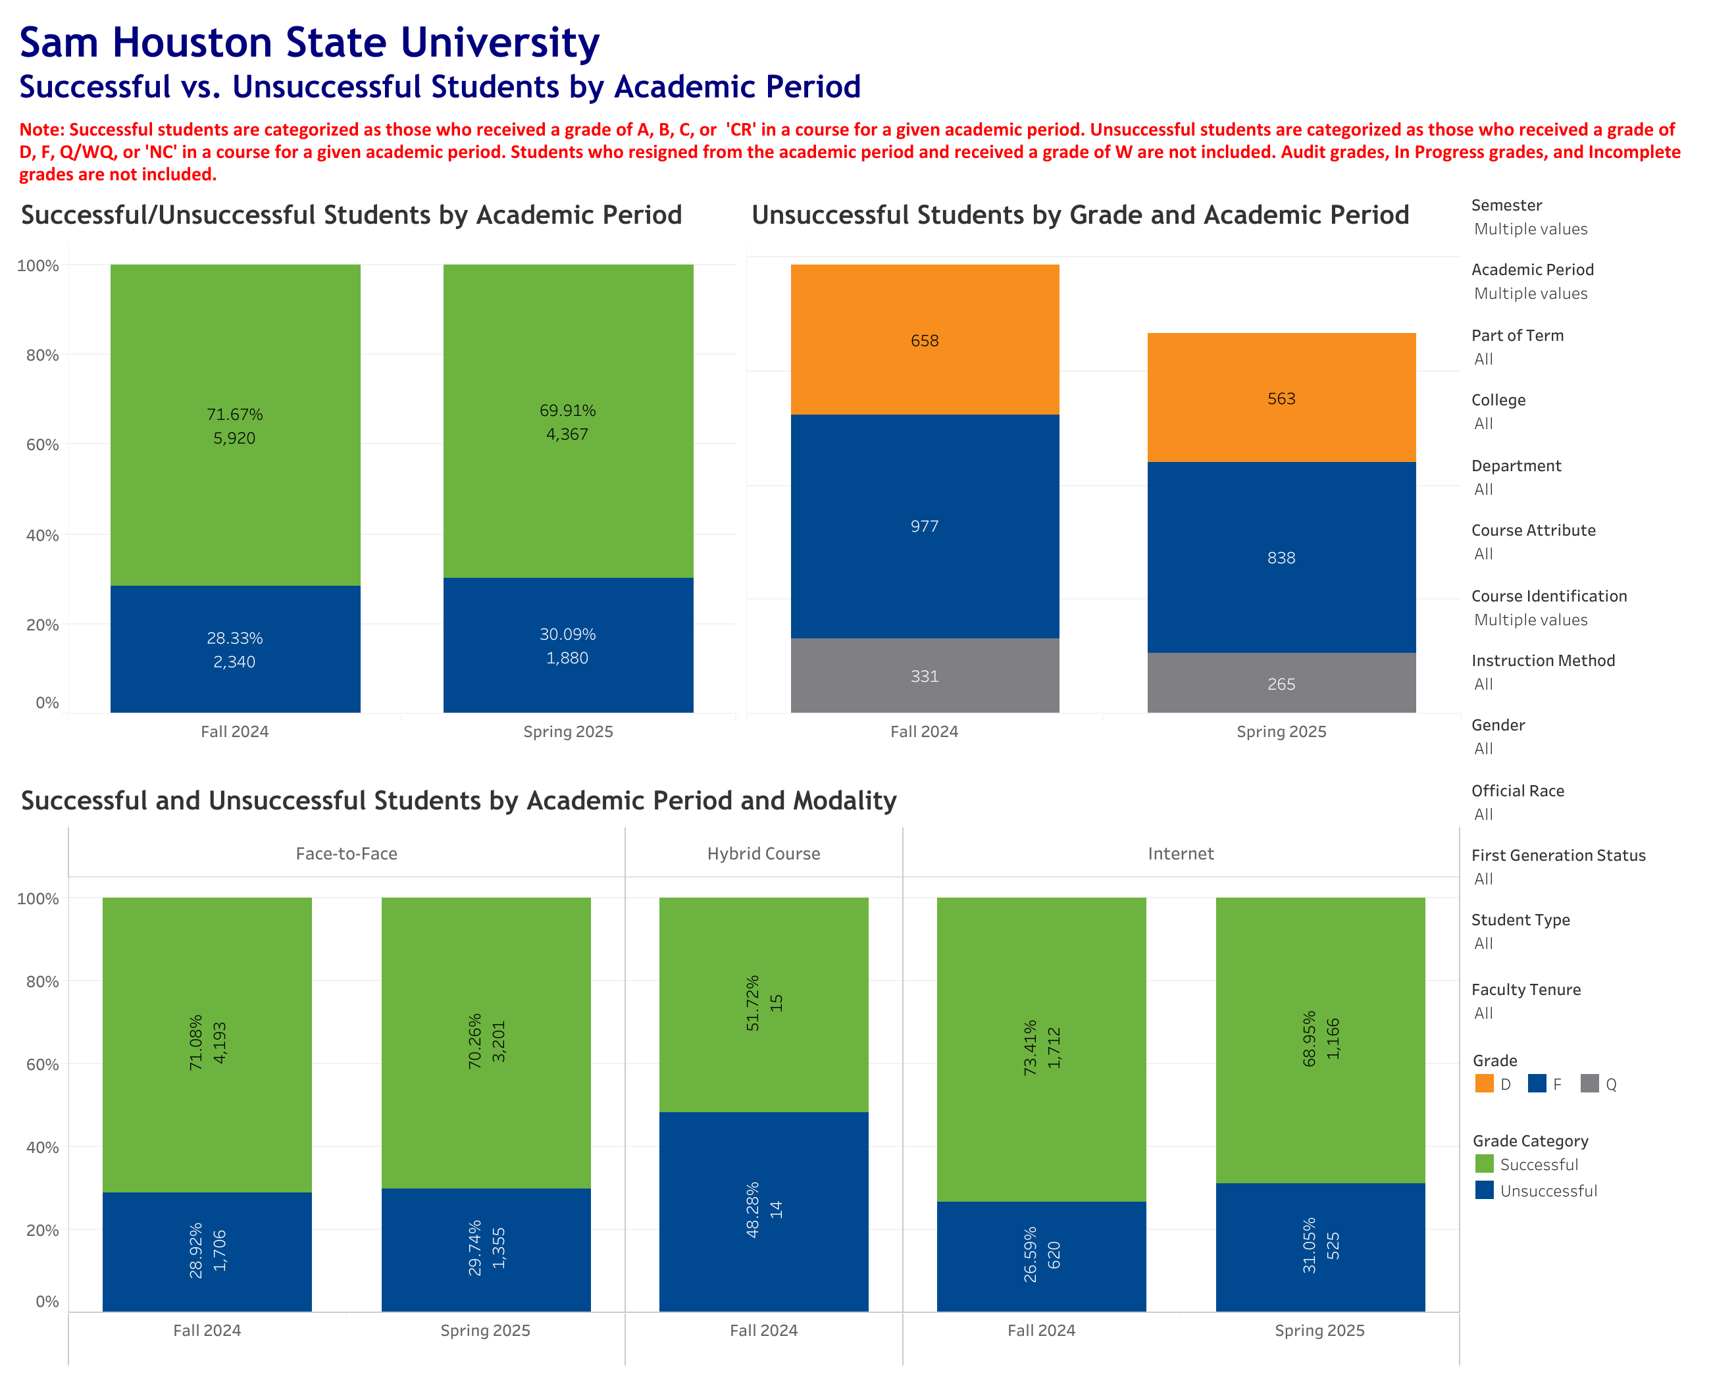
Redesigned courses F24-S25
CHEM 1411, ENGL 1302, ECON 2301, ACCT 2301, MATH 1314, MATH 1420, INRW, ACCT 2302, BANA 2372, BIOL 1408, GEOL 1404, HIST 1301, ECON 2302, MATH NO14, MATH NO24, MATH NO32, and MATH NO42. [NB: We are not reporting success rates for UNIV 1101.]

Slide 3
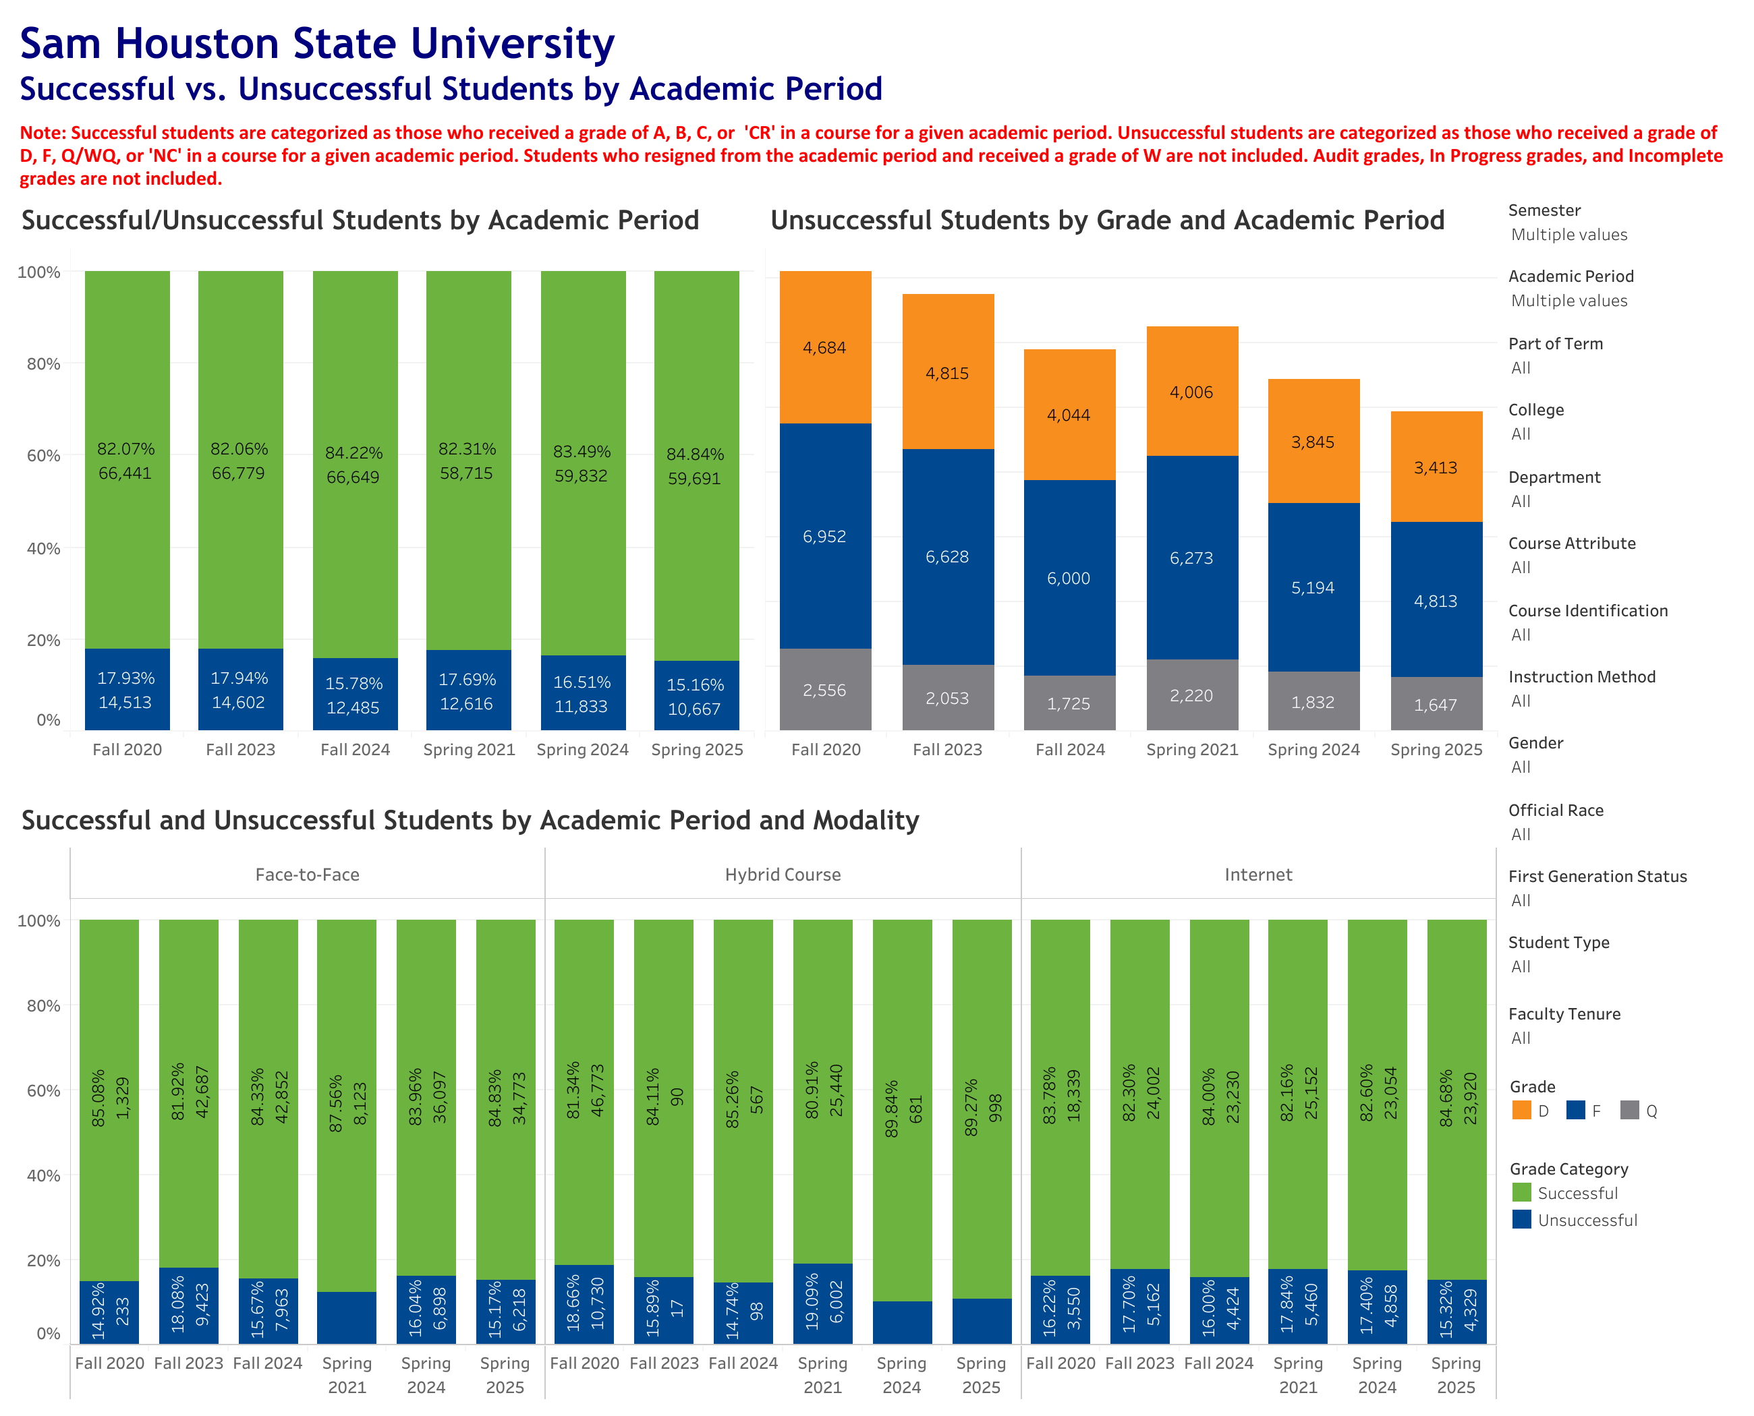
All university courses Year 0 and year-on-year

Slide 4
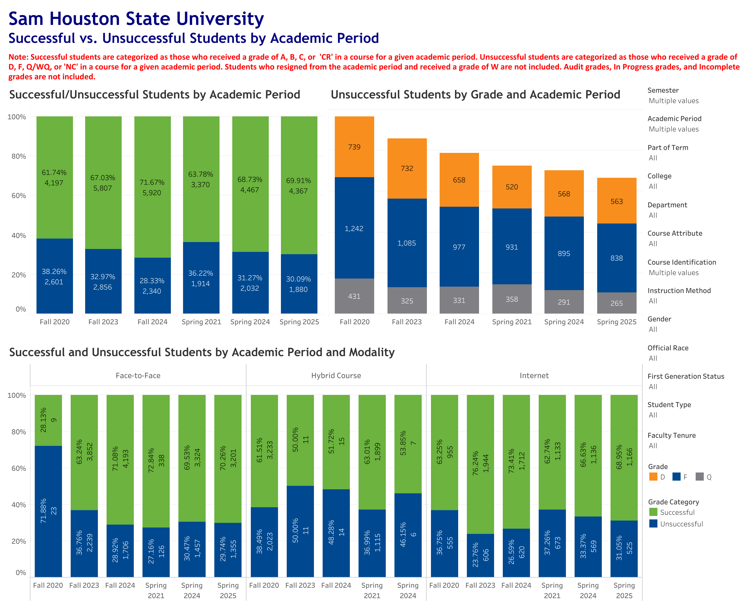
Redesigned courses Year 0 and year-on-year

Slide 5

Redesigned courses Year 0 and year-on-year without MATH NO42
b/c no NO42 in Year 0

Slide 6
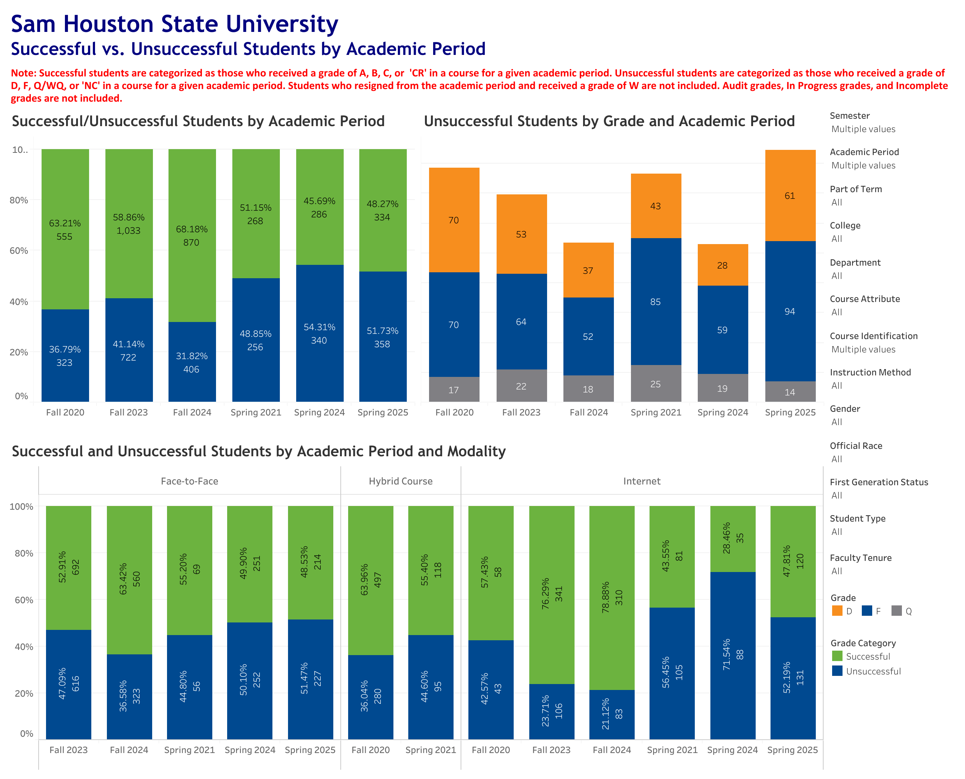
ECON 2302
MATH NO14
MATH NO24
MATH NO32
MATH NO42

Slide 7
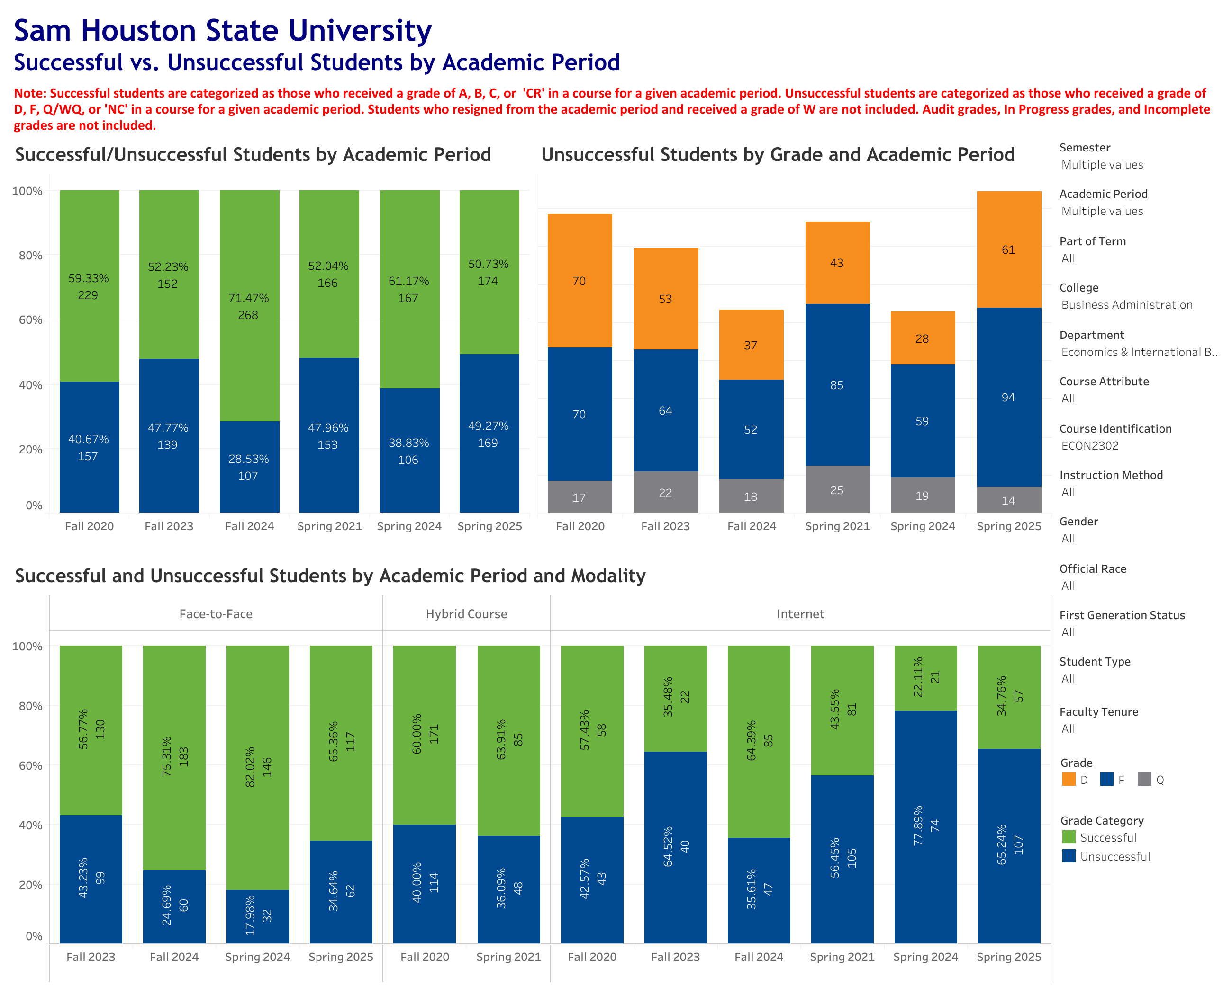
ECON 2302

Slide 8
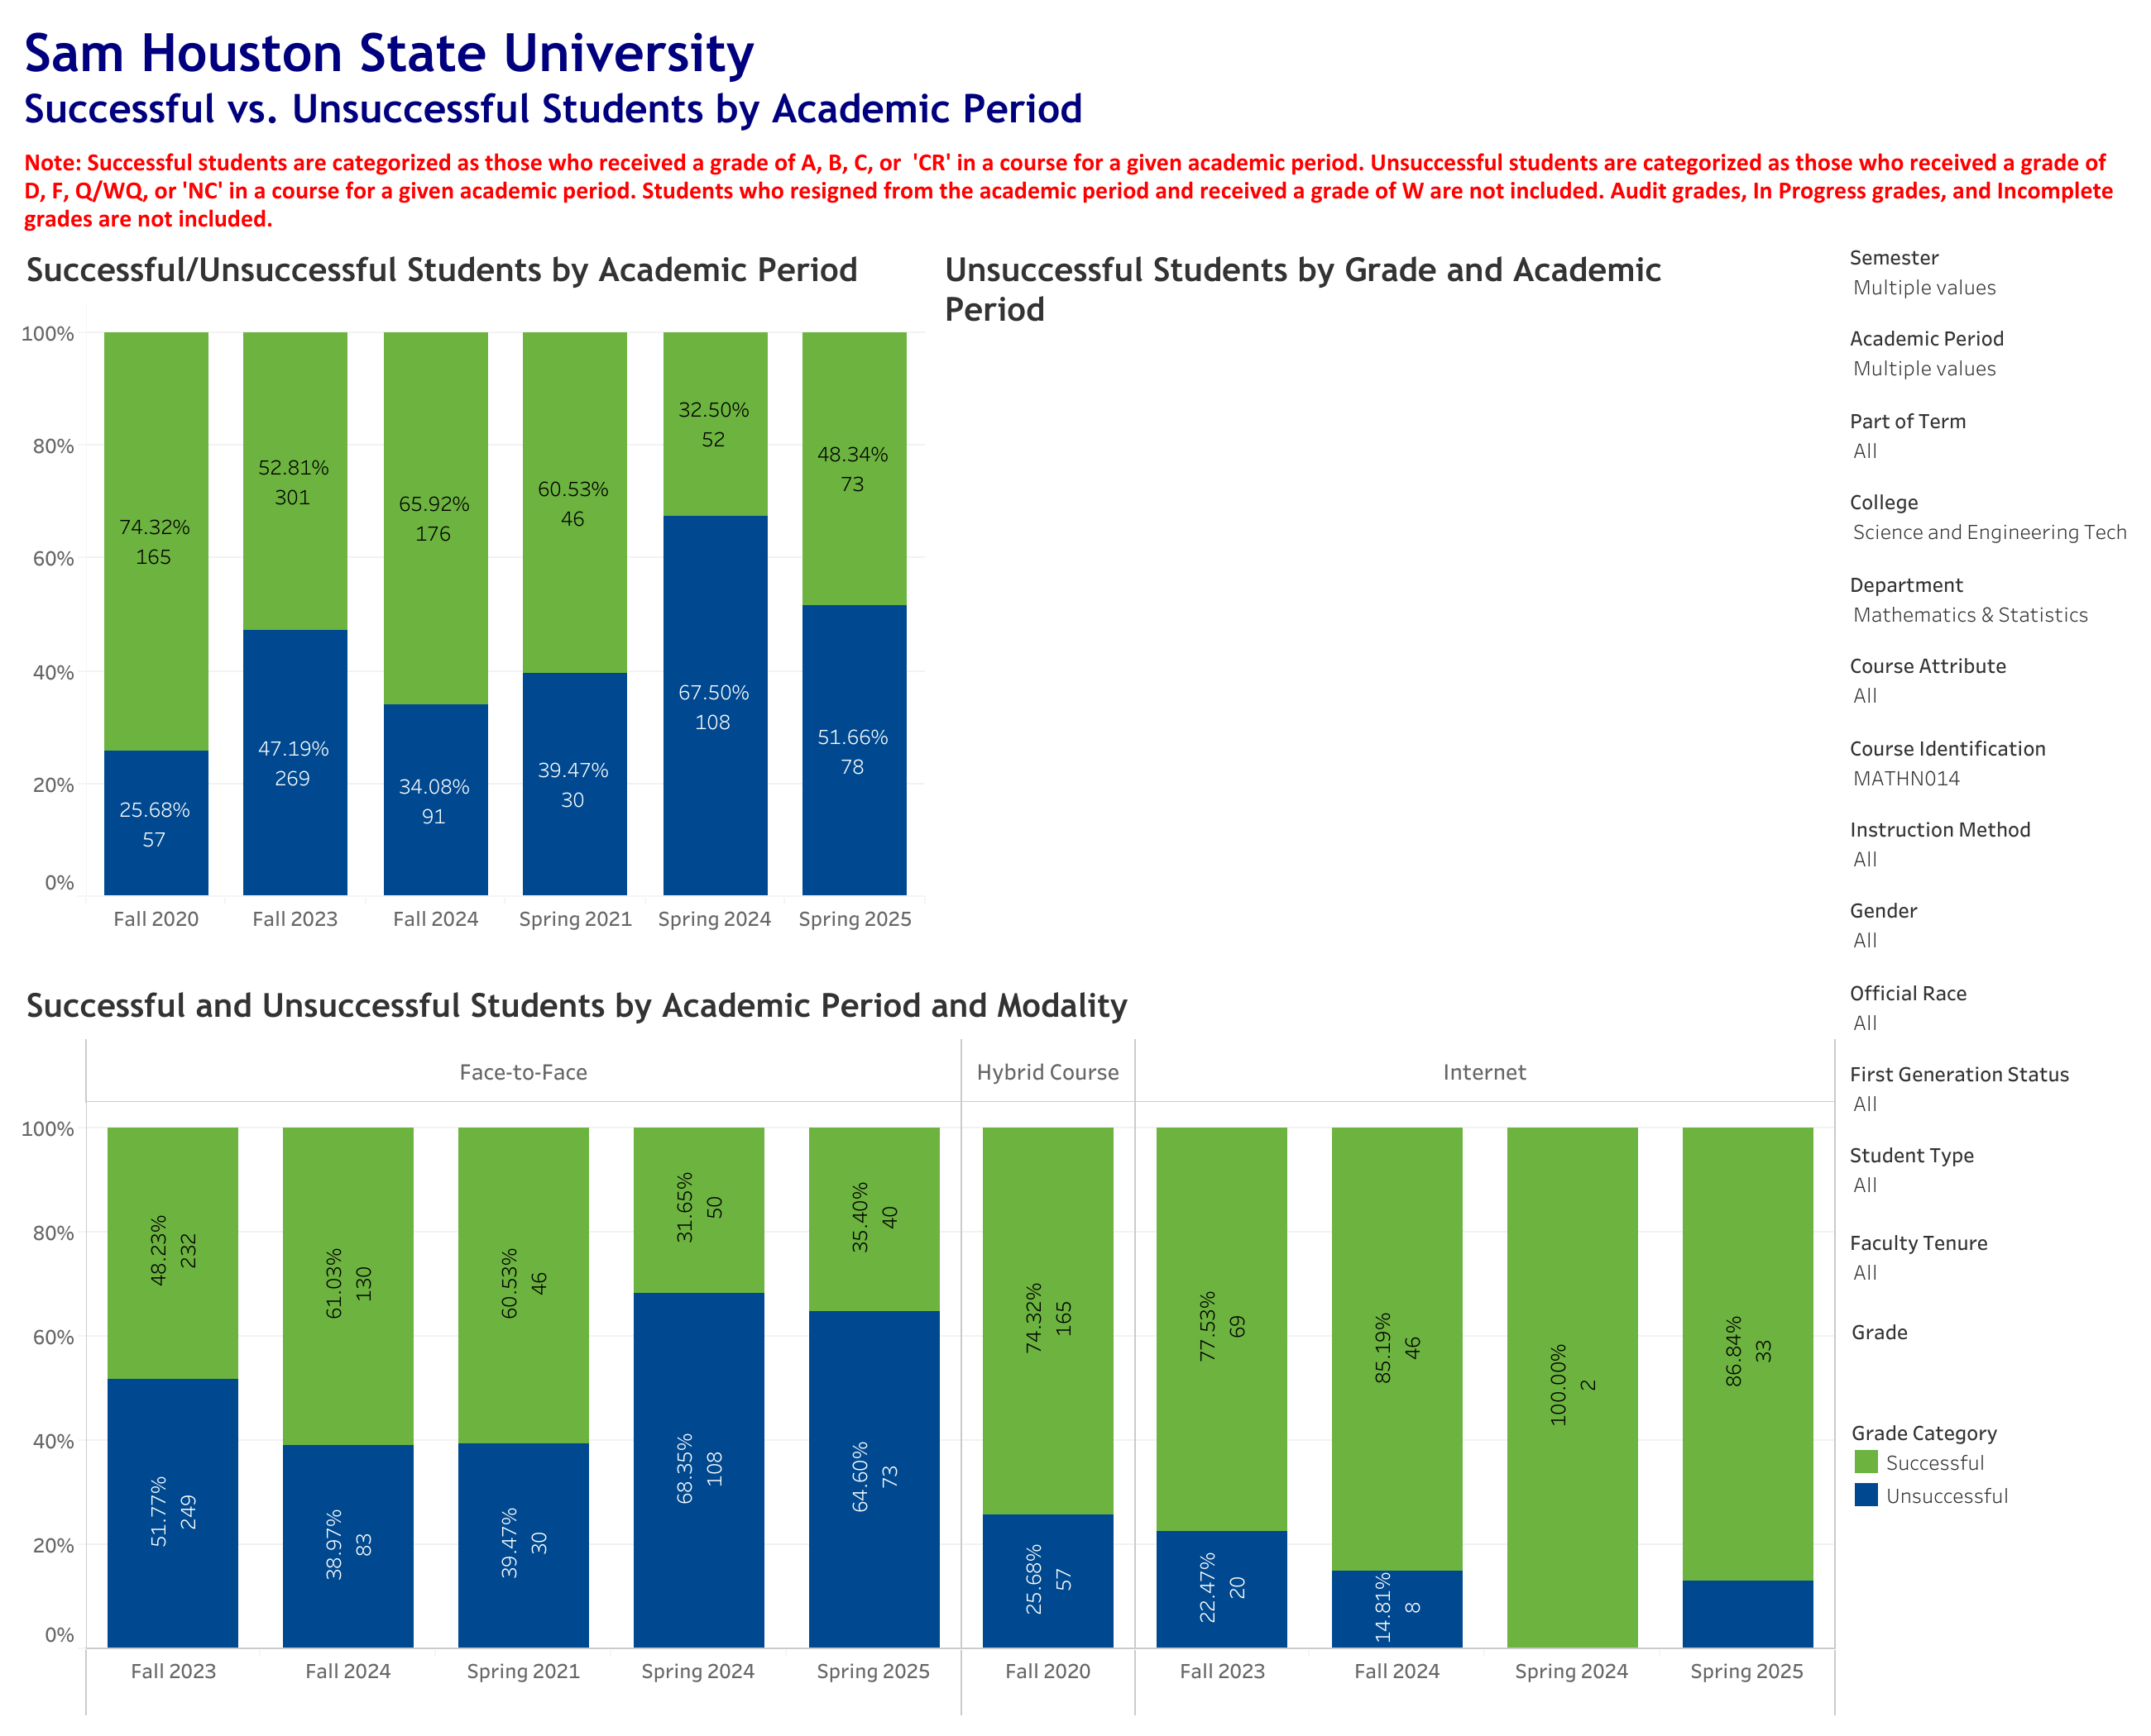
MATH NO14

Slide 9
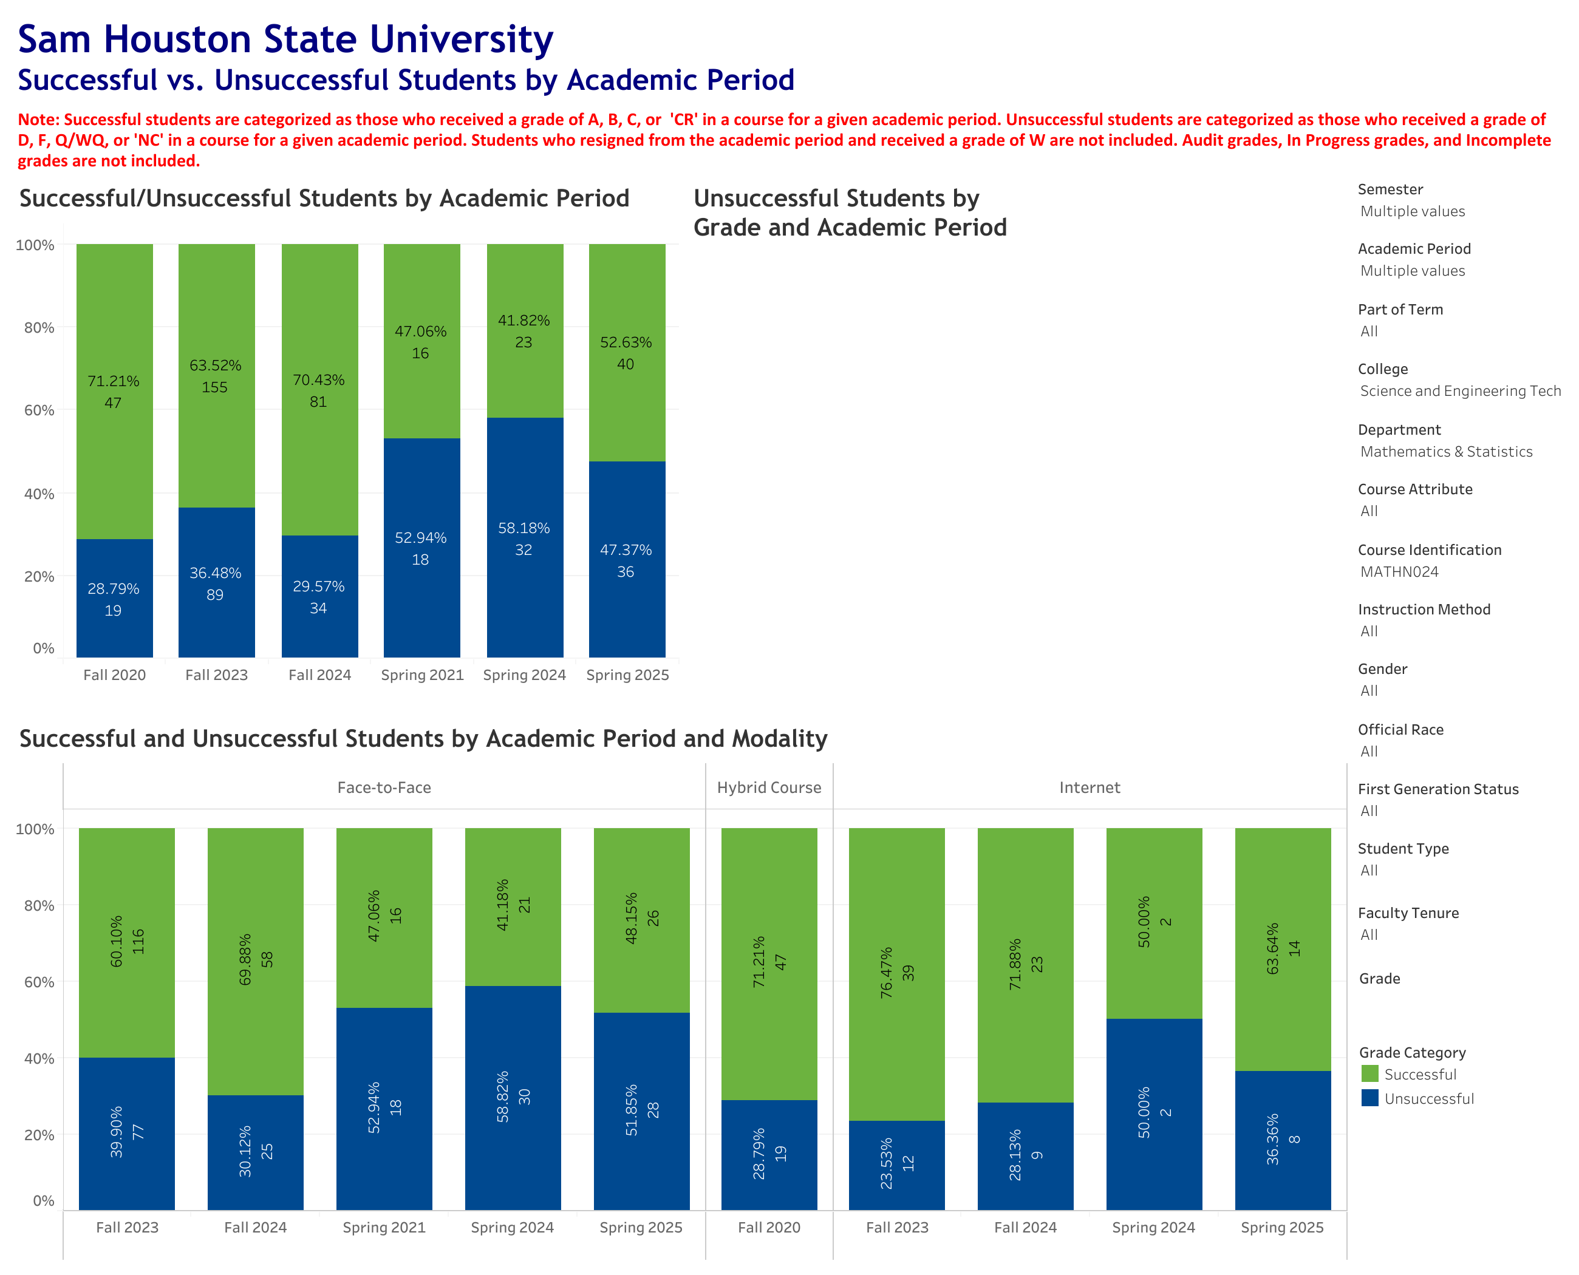
MATH NO24

Slide 10
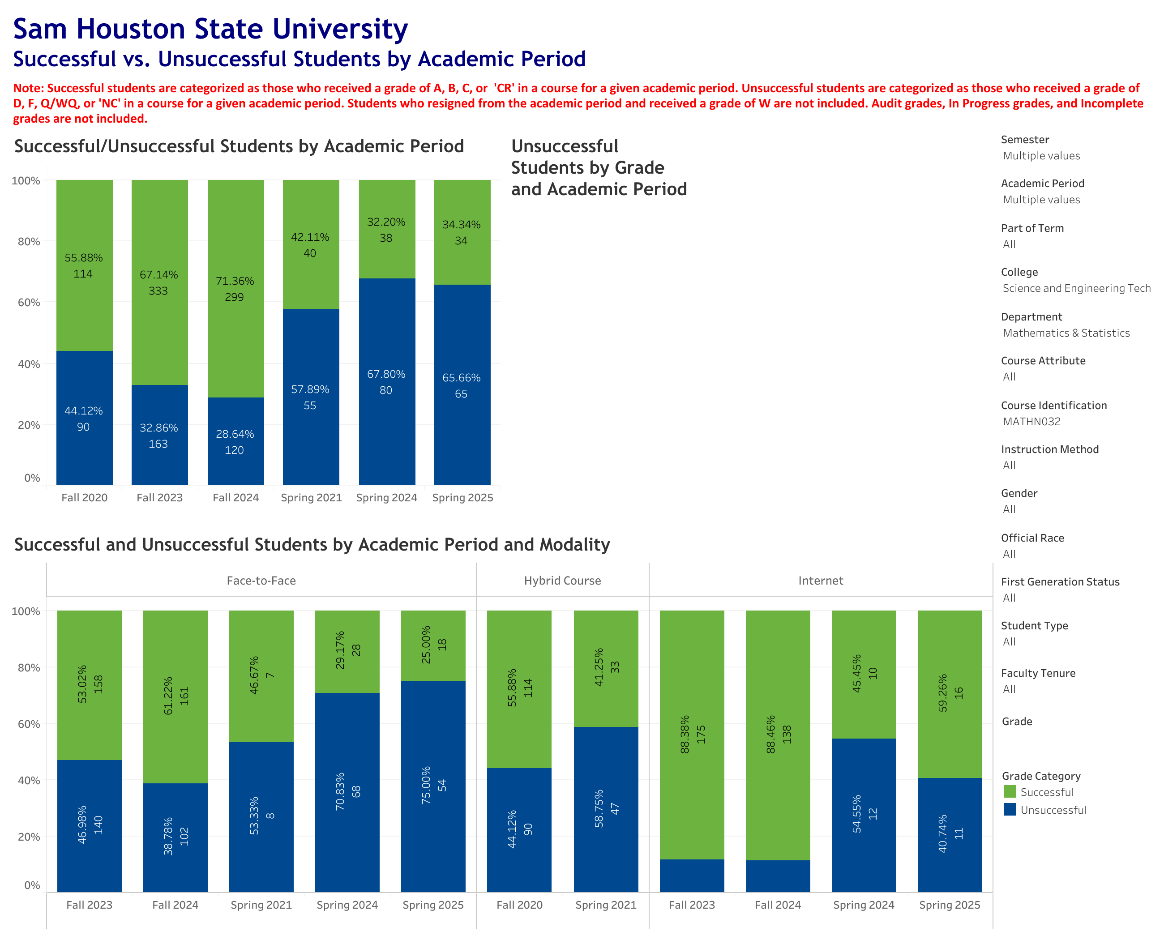
MATH NO32

Slide 11
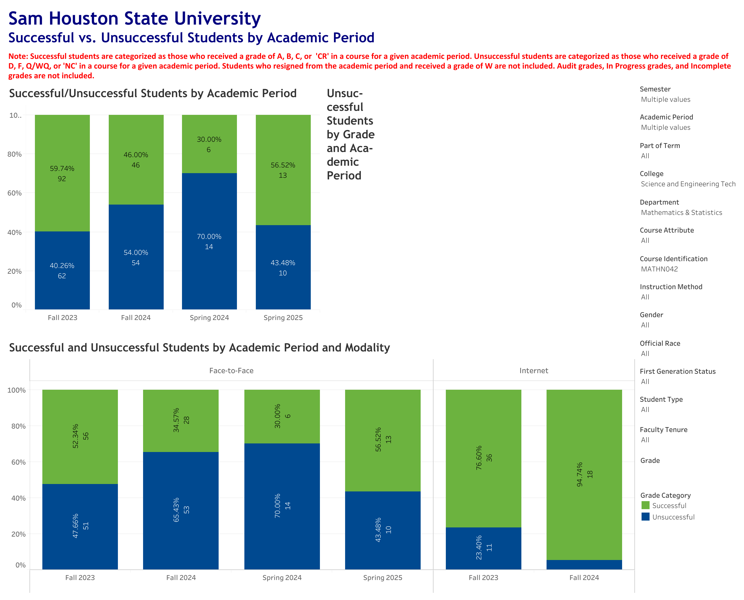
MATH NO42

